Slide 1


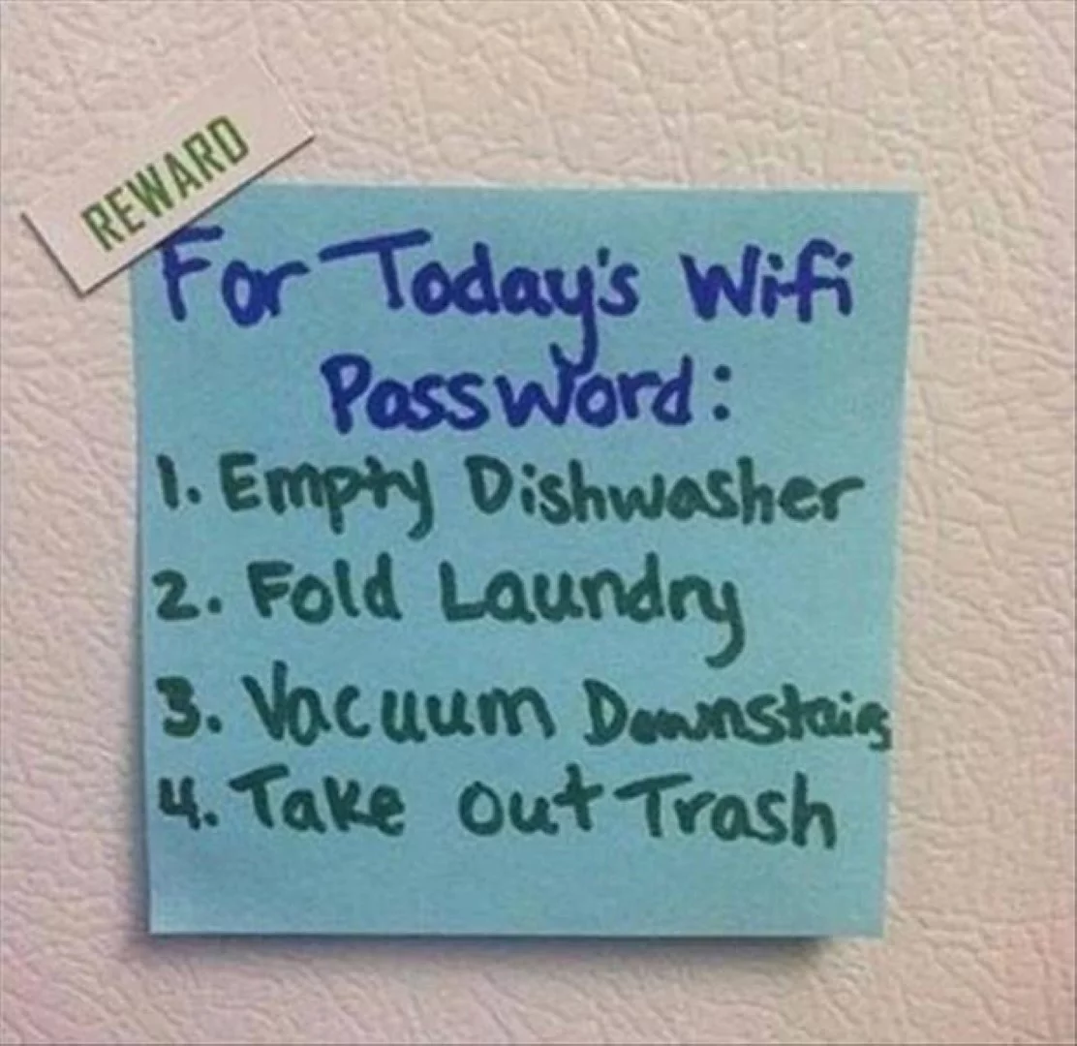
Digital Citizenship/E-safety
Parent Presentation
School Name
Date of Presentation
School Logo
Notes:
Welcome to [Name of School etc…and any ‘housekeeping’]. Thanks for coming along to our Digital Citizenship/E-Safety Presentation to Parents. We hope that you will enjoy this session and that you will discover a little more about the incredible opportunities that exist online as well as leaving here a little more prepared for supporting your child as they navigate their way through the internet.
This presentation will take the form of a few video clips for you to watch which illustrate some of the threats and dangers online, as well as some facts and figures that may reinforce the need for all parents to take a closer involvement in helping young children stay safe online. There will also be some tips and hints for things that you can do to make online exploring a little safer and thus making you a little more prepared for what your child is already/going to face in the digital age.
My name is [Introductions etc…]

Slide 2
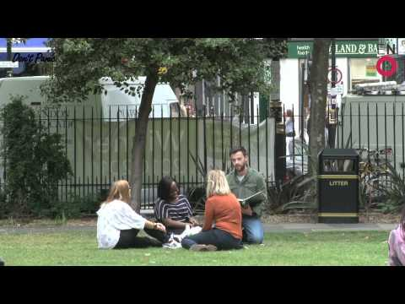
The internet...the greatest invention of our time?
Notes:
A good place to start is to reflect on how children (and adults, I suspect!) seem to live by a set of different ‘rules’ when online from when they are in the ‘real world’. This excellent video highlights in a light hearted way, just how odd and strange some of our online behaviour is, when it is applied offline! When you see some of the online behaviour shown in this way, it really does make you think…
[Click on the image to link to the film]
Which online behaviour looked the strangest when transfered to the ‘real’ world?

Slide 3
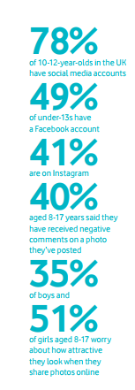
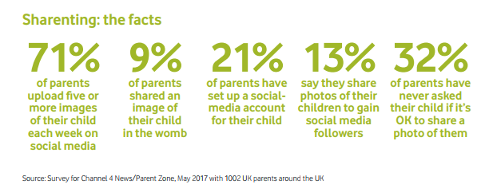
Usage of social media...
Can you guess how much time these age groups spend online per week?
3 and 4 year olds?
5 to 7 year olds?
8 to 11 year olds?
12 to 15 year olds?
3 to 4 year olds-6.5 hours per week
5 to 7 year olds 9.2 hours per week
8 to 11 year olds 17 hours per week
12-15 year olds spend well over 30 hours per week
Notes:
There are many, many stats produced which link in to E-safety but many of them become outdated almost as soon as they are created! These stats are the most updated figures that we can find. We are starting off by looking at how much children (and adults) actually use the internet and social media specifically. Take a few minutes to take in the figures-some of which may surprise or shock you. [Pick out a couple from either horizontal or vertical ‘banner’ and ask for reaction. The ones that seem to get a sharp intake of breath are the ‘13% who share photos of their children to gain more followers’ or 21% of parents setting up a social media account for their children’]
Ask the parents to call out the answers to these usage questions [the answers will be revealed through a second click on this slide so if you wish to keep them hidden, don’t click until ready!]
3 to 4 year olds spend 6.5 hours per week
5 to 7 year olds spend 9.2 hours a week
8 to 11 year olds spend 17 hours per week
12-15 year olds spend well over 30 hours per week
[NOT on the slide but might be worth asking as a final question in this section]
On average, how many messages do teens send per month?
Teens send and receive an average of 1,500 messages per month

Slide 4


Young People and Social media
Half (49%) of young people questioned say they have given out personal information online
5% of parents think their child has given out personal information online
BUT by contrast …..
Notes:
[Show the stats first] Nearly 50% of the young children asked, admitted to giving out some kind of personal information online. This could include their name (full or part), their address, their (actual or ‘pretend’) age, the school they go to, hints for their passwords, information about what they might be doing in an evening or at the weekend etc… However, when the parents of these children were asked, only 5% believed that their own child would share such information. If this doesn’t make you sit up and at the very least, reflect upon how well you know your child’s online behaviour, then maybe nothing will!

Slide 5
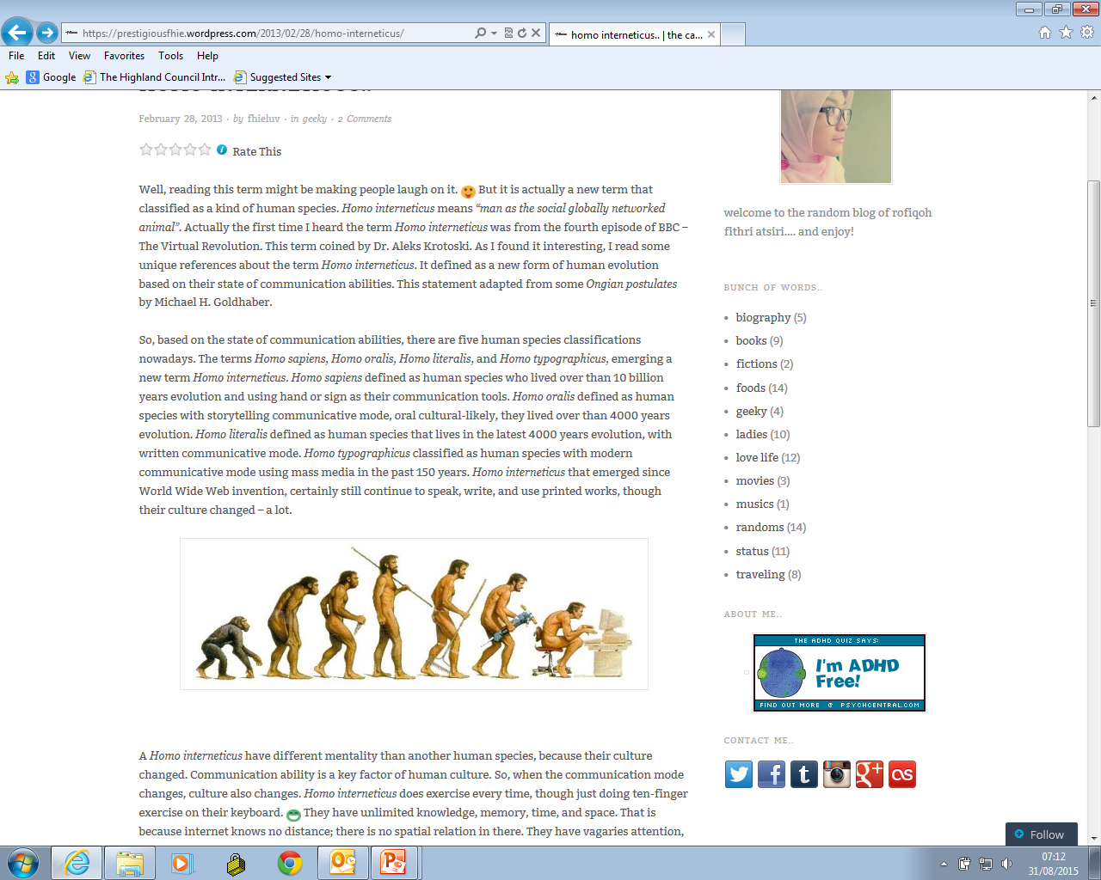
Benefits of the internet?
Homo interneticus
Notes:
So..hopefully you are now convinced that internet usage is only going to continue increasing and the age profile of the online user is getting lower and lower…so we need to help direct children towards the positive benefits that the internet brings and in particular, from online learning in school and at home.
The following clip (created by CEOP) highlights some of the many, many benefits that exist online! As you watch this clip, see if you can think of any other benefits that are not mentioned…
If you asked your child at home, what would they pick out as the most important benefit to them?

Slide 6

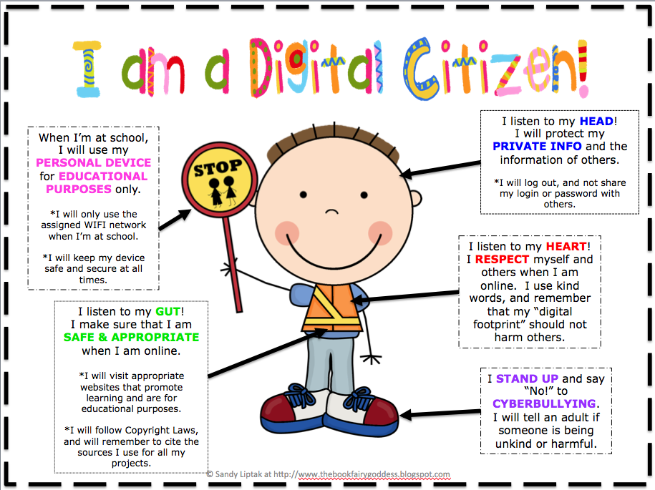
aiming to make highland’s children, digital citizens
'Children and young people are innovative, confident and responsible in the use of technologies and staying safe online. They critically examine and make informed choices about the use of digital technology to enhance and personalise learning in school and where appropriate, beyond the school day. They anticipate and respond to new opportunities and threats caused by developments now and in the future.'
(National Action Plan on Internet Safety for Children and Young People, 2017)
Notes:
Earlier this year, Scottish Government released national guidance in the form of the National Action Plan on Internet Safety for Children and Young People and this has been issued to all schools across Scotland. As the above quote identifies, they identify that online learning is now taking place beyond the school day and therefore there is a need to ensure that our children are ready to respond to new opportunities created but also, any new threats as technology develops further.
The hope is that as Highland Schools become more strategic and ‘joined-up’, so do other parts of Scotland, so that we have a consistent and progressive approach to tackling E-safety in order to make our children Digital Citizens.

Slide 7
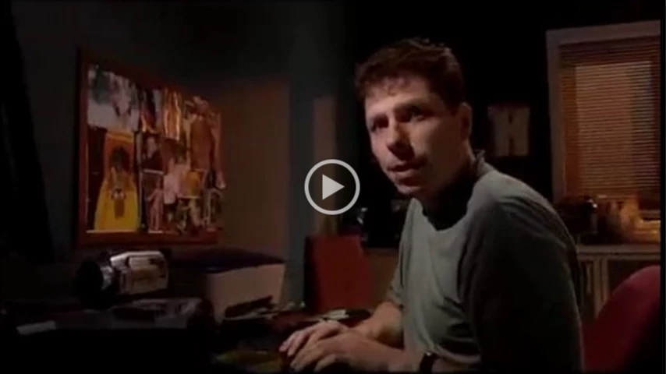

Sadly, despite the numerous benefits of the internet,threats and dangers do exist...
Virtual Global Taskforce video created by CEOP
Notes:
As you have seen in the previous video there are many, many benefits to online learning. However, there are also sadly a number of threats and dangers that lurk around the virtual corner. Take a look at this very short video which illustrates one of the most obvious challenges in keeping our children E-safe.
[Click on the image to link to video]
The internet is a great place for meeting new people but as the clip shows, it also allows people to ‘hide’ behind their screen and pretend to be someone who they are clearly not both in age, gender and in their likes and interests. This is perhaps the biggest threat to our youngsters who are too ready to believe that people are, who they say they are and unfortunately, there are adults out there who wish to take advantage of this opportunity.

Slide 8
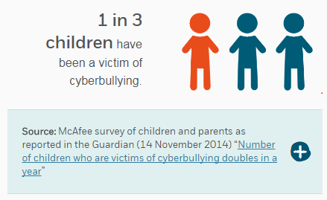
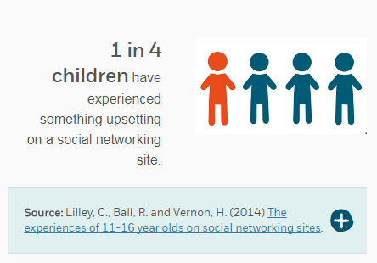
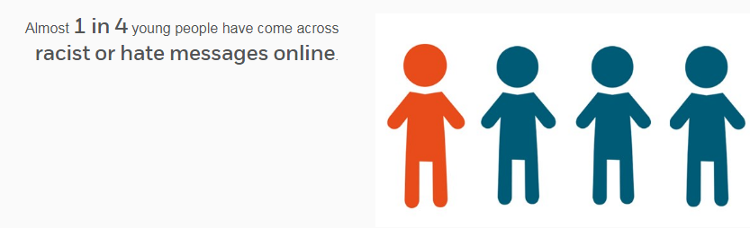
And some more facts and figures...
Notes:
Here are some more stats to make you think about how the internet plays a part in your own child’s life and where some of the other threats lie. [Read through the stats, as you see appropriate, pausing to take any comment or feedback on the information provided]

Slide 9


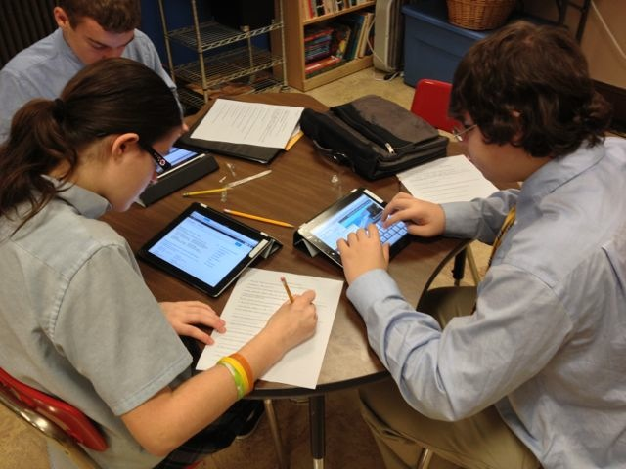
So why is internet safety so important in highland?
Why does a ‘One to One’ Chromebook create Digital Learning Opportunities?
Individual ( and secure) PUPIL PROFILES
RECORDING LEARNING using Google Docs, Google Slides and Google Sheets to work COLLABORATIVELY
Ready ACCESS TO INTERNET for research and exploration
Access to APPS to support learning on own device
Ready access to a CAMERA/VIDEO to capture learning
Notes:
As you will hopefully be aware, Highland Council have just begun a rollout of one to one devices across a number of Highland Schools. This means that each pupil in P6 and P7 will be given their own Chromebook which will be accessed both in school and also at home. All secondary pupils from S1-S6 will receive a Chromebook device which will be used in the same ways as in primary. This means that children in Highland will be able to have online access both at school and (hopefully) at home and this is why work on E-safety has been so important so that they are well-prepared for this innovative approach to learning both in terms of the potential advantages and benefits but also some of the threats and dangers. However, most important in all this, is ensuring that all children know what to do, should they find themselves in an online situation that they are not comfortable with.
This roll out is happening over 18 months and is being done ASG (or Cluster) by ASG. It is likely that our children will receive their Chromebooks in [Insert most up to date information about the likely rollout date...if unsure, please contact Seb O’Dell or Andy McCallum for info]
This is very exciting and Highland are leading the way across Scotland with this approach which will not only impact on P6-S6 but also on P1-P5 whose classes will also have an increase in the number of ‘mobile devices’ available to them in class (these devices will NOT go home for P1-P5).
You may be curious to know what types of learning may be enhanced by pupils having a 1:1 device and some of the ways are listed on the screen:
Pupils having an individual (secure) PROFILE...for capturing learning, reflections, target setting and above all, being able to share this with family and friends instantly as well as hopefully getting feedback quickly
Pupils using G-Suite to RECORD LEARNING including Google Docs, Google Slides and Google Sheets Pupils to work COLLABORATIVELY. This means that any number of pupils can be working on a Google Doc, for example, at the same time so they are able to create posters, reports, stories that have had input from small or large groups of other people.
Pupils having ready ACCESS TO INTERNET for research or information finding...in schools at the moment, having access to the number of devices necessary to allow each child to carry out research or explore is almost impossible. This 1:1 rollout means that each child can now do this either at school or at home and therefore they can ‘satisfy’ their curiosity immediately rather than having to wait until a machine is available or free
Pupils having access to a huge range of APPS to support learning...there are so many purpose built apps which provide opportunities to develop, extend or reinforce learning
Pupils having ready access to a CAMERA/VIDEO to capture learning...children will now be able to capture learning in a much wider range of ways such as videoing themselves talking about how they carried out a task, videoing the actual task itself being done or simply by taking a photo of their end product.
There are many, many, many other ways that this exciting roll-out is going to enhance learning and teaching….

Slide 10
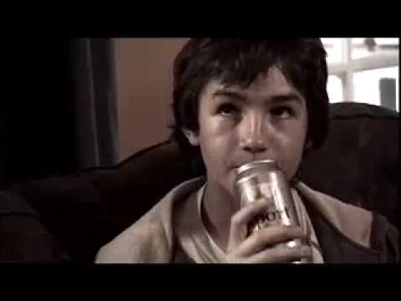
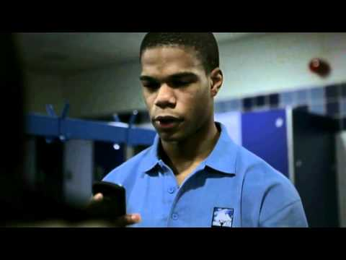
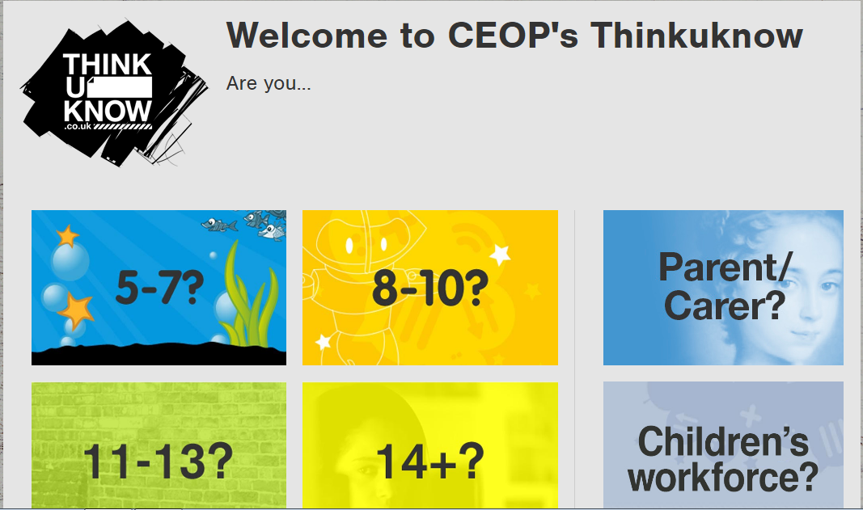


E-Safety in School
“Exposed”
“Tom’s Story”
CEOP (Child Exploitation and Online Protection Centre) is a command of the UK's National Crime Agency (NCA) and is tasked to work both nationally and internationally to bring online child sex offenders to UK court.
Notes:
When you look at statistics written down, it is very easier to become complacent and forget that each of these stats involve very real children and unfortunately, very real situations that these children have found themselves in. We are now going to watch two short video films made by CEOP (Child Exploitation and Online Protection Centre) which are used with different ages of pupils to send a hard-hitting message that issues and challenges can happen as a result of online behaviour.
CEOP (Child Exploitation and Online Protection Centre) is a command of the UK's National Crime Agency (NCA) and is tasked to work both nationally and internationally to bring online child sex offenders to UK court.
The first film, Tom’s Story is a classic example of a young boy who gets caught up in the online game he is playing and ends up befriending what he thinks is another boy of similar age. Caught up in the excitement at the opportunity of training with his new friend, Tom forgets all of the rules and advice given about never meeting unknown people in the ‘real’ world.
In the second film, Exposed, the teenage girl decides to take her relationship with her boyfriend a step further, ‘safe’ in the knowledge that she believes him to be trustworthy and able to handle the photos that she prepares to send him. This clip is very effective in showing children how one mistake can snowball into something much bigger and go ‘viral’ before you know it.
[After the clips, ask the parents for thoughts and comments. Where any parents surprised or shocked by what they saw? What age range would they expect each video to be targeted at?]
These videos are both used as part of a school’s E-safety programme and allow for very productive discussion afterwards and at the respective ages targeted, can provide something of a ‘shock’ factor. Children can relate to the ‘real-ness’ of the clips as they can see that the characters in the videos are just ‘normal’ children like themselves.
The decision about when to show clips like these is really down to individual school/class/teacher judgement as to the maturity and/or needs of the children involved. It is fair to say however, that the target age range is coming down every year and whilst for example, Tom’s Story may have been viewed as something that a senior class at primary school would watch, the harsh reality is that in order to be ‘pro-active’ and in terms of early intervention, many schools are including this film in their E-safety programme at an earlier stage.

Slide 11
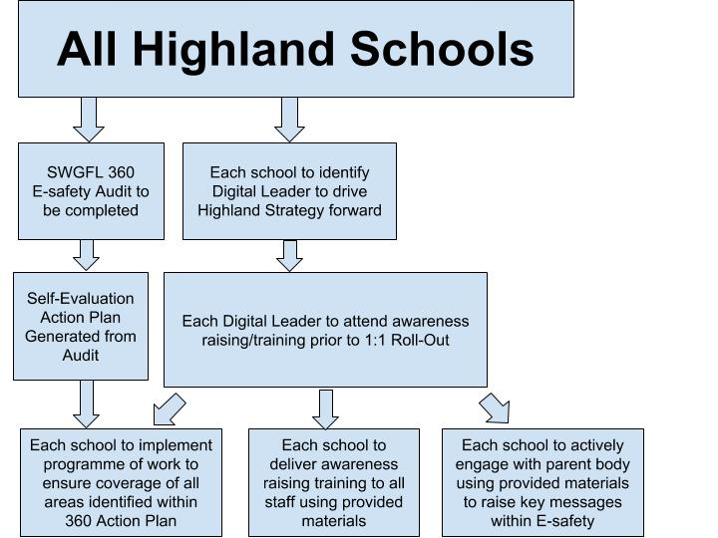
Highland E-safety Strategy?
Highland Schools’ E-safety Strategy has been created and as schools are being rolled-out Chromebooks for the 1:1 model, they are following this step-by-step approach
Notes:
Each school is expected to follow the Highland Strategy as shown in the flowchart so by the very fact that you are here today for this parent session, our school is well underway towards covering all of the expected stages. The reason for the creation of a strategy is that across the many Highland Schools, there have been ‘pockets’ of good work being done but none of it has been coordinated or joined up. Until now, of course! The hope is that as the 1:1 roll-out continues and children in P6 and P7 and S1-S6 are given their own Chromebook, schools will be far more confident that they have put in place the ground work to ensure that staff and pupils are more aware of how to become digital citizens.

Slide 12
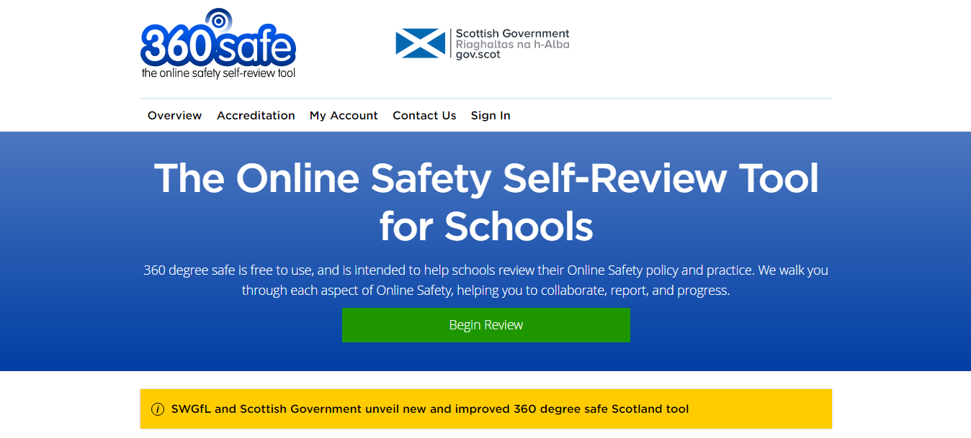
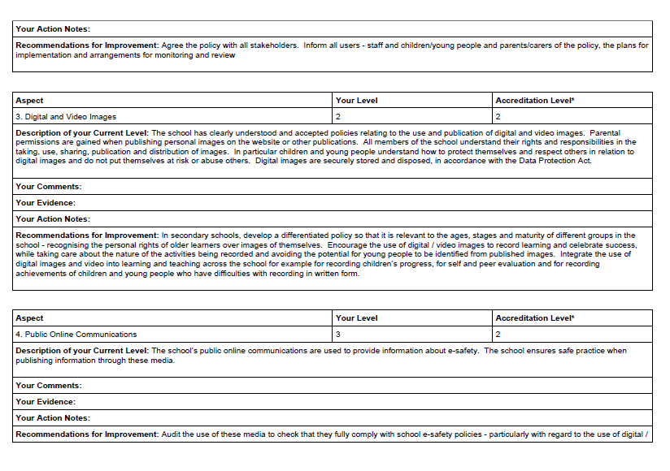
SWGfL 360 Audit tool
Endorsed & supported by Scottish Government
Self-Evaluation
Action Plan
Notes:
Every Highland School will be expected to carry out an audit of how Internet Safety is being delivered and managed in their own school.
After the school has completed this self-evaluation, an action plan is generated which lets pupils, staff and parents see which aspects of E-safety are being covered well, and where extra focus or additional teaching and learning may be needed.

Slide 13
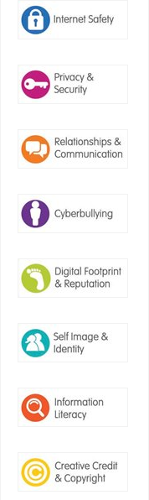

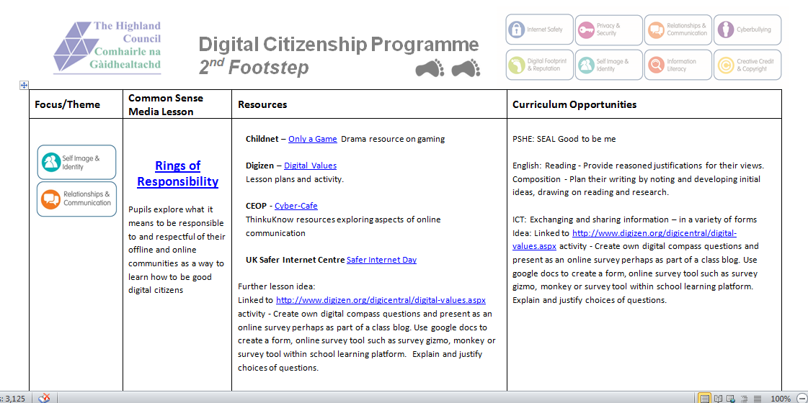

What Schools are Doing about E-safety
These are the categories that schools will be planning their E-safety Programme of Work around
Notes:
A Highland Programme of Work for Digital Citizenship has been created and all schools have access to this programme and many schools will use this programme to supplement the approaches and resources they already use. However, schools are encouraged to develop their own unique ‘slant’ on how to approach the delivery of E-safety in their own school. Many schools will build this into their Health and Well-Being/Personal Social Development lessons, or some may tackle certain topics as ‘standalone’ lessons. There may also be opportunities in primary schools to build this learning into ‘topic’ or ‘project’ work.
This programme of work will likely involve making use of a great variety of different resources which offer different slants or approaches to covering certain threads within E-safety.
This Highland Programme will ensure that there is a more robust overview of what skills and learning should be covered as well as making close links to the Experiences and Outcomes as outlined in the Curriculum for Excellence. As you can see above, the programme is divided into a number of categories which cover the key areas to be explored within E-safety.
You will see a phone with both Highland Council and Police Scotland logos together. This is a useful reminder that much of the learning that goes on within Highland Schools is done in partnership with other agencies or organisation. There is already a very close working relationship between the local police and schools where police officers will come in and present a ‘real life’ context based on their daily happenings.

Slide 14




CHROMEBOOK SECURITY
Whilst in school, internet access via the Chromebooks is filtered via a product provided by Fortinet
RM Buzz is used to gather data each time a user accesses an online site
RM Buzz gathers data per user and not per device so pupils MUST logout when finished using Chromebook
Whilst out of school, internet access via the Chromebooks is filtered and monitored through RM Buzz
Parents are advised to link any home Broadband filtering to their child’s Chromebook (and any other devices they may have) for further protection and security
Each time a user logs onto a Chromebook, they are agreeing to the council’s Acceptable Use Policy (AUP) which includes use in and out of school hours/grounds
Notes:
When your child is using their Chromebook in school, their internet access will be filtered using a product provided by Fortinet which filters access based on category sets. The allowed and denied category sets have been selected as those best suited for your child’s education. Although best endeavours are made to control internet content these is still a risk that some traffic gets through the filters. If this was to happen then it is important that your child makes contact with a member of school staff to report the incident as soon as it happens.
In addition to filtering within school, we have installed a product called RM Buzz. RM Buzz allows all content viewed and accessed on the Chromebook, both at home and at school, to be gathered and where required (and permission granted), this data can be monitored and explored. When your child is using their Chromebook out of school, the internet access will not be filtered. However, traffic will still be monitored though RM Buzz and will also retain a record of content viewed.
It is advisable that your add your own Broadband filtering package at home. Not only will it protect to your child when using the Chromebook but it will also protect your child when using any other internet device in the home.
It is important to remember that each time your child logs onto their Chromebook device (both in and out of school), they are agreeing to the terms and conditions of the Acceptable Use Policy that governs the whole of the council users. They have been agreeing to this already, each time they log onto any machine or device in school so this is not a new thing but will obviously have more significance now we have so many devices being given out.

Slide 15
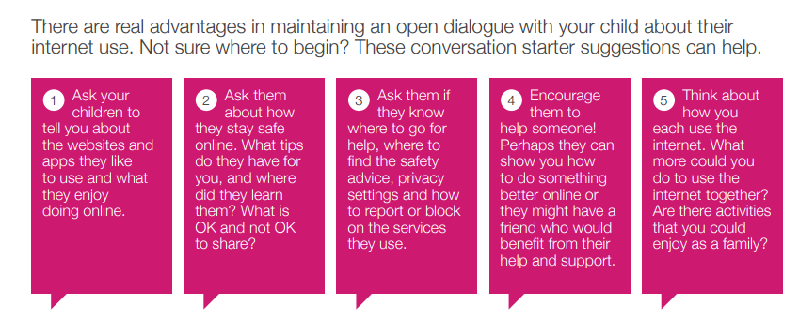
Parents-Talk the talk! Be‘e-interested!’
Notes:
All of the fantastic resources that exist to help and guide parents are very helpful and very handy...however, there is only really one way to fully support your child towards being a Digital Citizen. And that is to have regular conversations about the benefits and challenges, the positives and the threats, that exist online. Sometimes starting that conversation can be tricky so perhaps consider using the above ‘starters’ as a way to initiate that discussion. You will be surprised at how many children will actually welcome the fact that you are trying to become more knowledgeable about the online world and simply having that first conversation may persuade your child to ‘trust’ you should they ever need to discuss any online problem or issue.
You won’t manage to cover everything in one go, but by selecting the topic that is most relevant to you, you can tackle this at your own pace.
[Read over the 5 ‘starters’ and perhaps get feedback on how do-able these conversations might be. What challenges or obstacles might prevent you having a meaningful discussion based on each ‘starter’?]

Slide 16
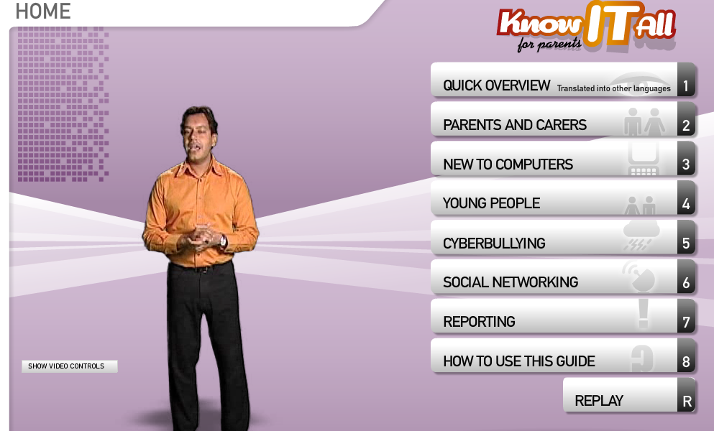
Websites for more information
Know IT All for Parents
Know IT All for Parents is a unique interactive e-safety guide for parents and carers produced by Childnet International.
http://www.childnet.com/resources/know-it-all-for-parents
Notes:
Know IT All for Parents is a unique interactive e-safety guide for parents and carers produced by Childnet International. It's designed to really help you as a parent or carer keep up to date with how children are using the internet, and support them in using these new exciting services safely and responsibly. You can watch the videos at your own leisure and at your own pace and as you can see from the menu on the screenshot, you can watch the whole presentation or simply select the ‘topics’ that you wish to see.

Slide 17
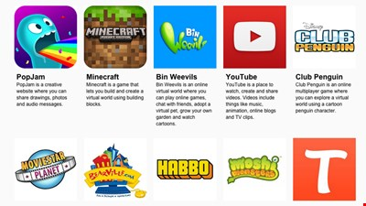
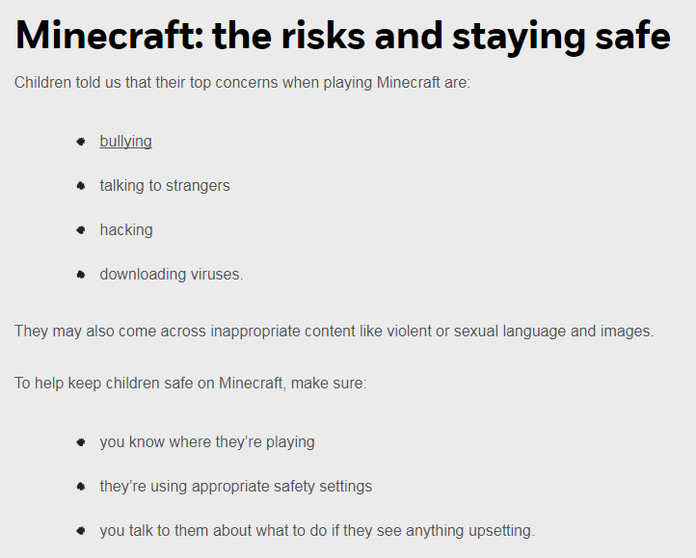

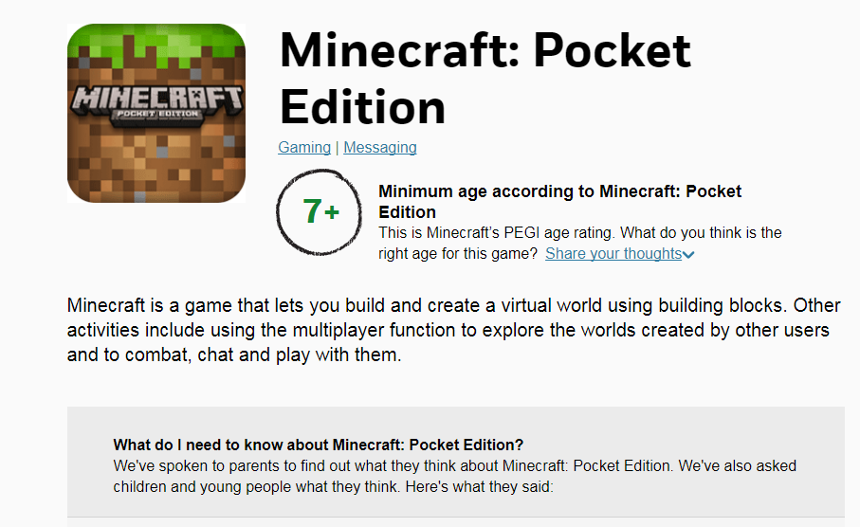
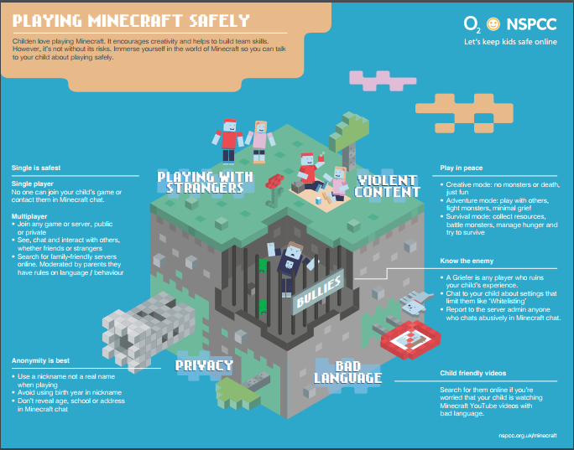
How can parents Negotiate the Online MINEFIELD?
A great place to start: net-aware.org.uk
Notes:
Technology is changing and moving at an incredible speed and as parents, it is almost impossible to keep up! However, there are some great resources out there that do a lot of this ‘exploring’ for you.
One such site is Net Aware which has been created by NSPCC and is a very user friendly site that allows you to explore what a huge range of social network sites and games are actually all about. The real attraction of this site is that it allows you to look at the site from a variety of different ‘angles’-from the viewpoint of a child, a teacher and other parents just like you. NSPCC make contact with each app/game that they review and feedback the ‘official’ responses in terms of the ‘target age’ range, the amount of violence, signing up process, reporting a problem etc…
This makes Net Aware a fantastic resource which could easily be used to start up a discussion about online behaviour and allow your child to tell you what they think, in comparison to the information and views presented on Net Aware. The site can be downloaded as an ‘app’ or by simply visiting the website at the address on the screen.
[If internet access is available, it is recommended that schools carry out a ‘live’ exploration of a chosen app or site. Go into the site and navigate through one of the more popular and well-used apps such as Minecraft (some screenshots above) to demonstrate the breadth of information this resource can provide]

Slide 18

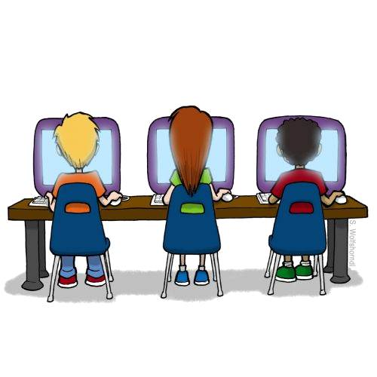
TALK about online happenings!
Set a family AGREEMENT
Discuss STRATEGIES to deal with inappropriate online content
Understand that some online behaviour may break the LAW
Familiarise yourself with PRIVACY SETTING and REPORTING features
BULLIED ONLINE - save evidence and report the incident
Look at AGE RATINGS for games and apps
Set up a FAMILY EMAIL address
Use NICKNAMES rather than full name online
Set up a PIN or password
Notes:
There are loads and loads of really great sites where you can pick up top tip after top tip! Here are a few that we think may be helpful in trying to create a safe environment for you and your child online:
Regularly, encourage your child to TALK to you about their internet use e.g. who they’re talking to, services they’re using, and any issues they may be experiencing
Create a family AGREEMENT to establish your children’s boundaries, and your expectations, when on the internet including agreeing lengths of time for being on devices/online
Give your child STRATEGIES to deal with any online content that they are not comfortable with – such as turning off the screen, telling an adult they trust and using online reporting facilities
Understand the LAW. Some online behaviour may break the law, for example when downloading or sharing content with others. Be able to recommend legal services
Familiarise yourself with PRIVACY SETTING and REPORTING features available on popular sites and services
If you think your child is being BULLIED ONLINE, save all available evidence report the incident e.g. to school, service provider, or the police if the law has been broken
Familiarise yourself with the AGE RATINGS for games and apps which can help to indicate the level and suitability of the content. Also see if online reviews are available from other parents as these may be helpful
Encourage your children to use nicknames (where possible) instead of their full name online, to protect their personal information, and create strong passwords for every account
Set up a PIN or password on devices to help protect personal information

Slide 19

Children will mirror how you ‘behave’ online
Model excellence!
“If children watch parents overshare photos and intimate or sensitive information about family issues, the child will assume this is appropriate online behaviour.”
Making sure that your account/profile is SECURE and not open to everyone.
Using APPROPRIATE language in posts or updates that might be seen by others (including your child and/or their friends).
Ensuring that any photos posted fit the ‘GRANNY RULE’ are done so with CONSENT from the person in the picture
Taking a POSITIVE SLANT in your posts/updates. Question whether posting negative statements online is most effective way to deal with it
Notes:
One of the most important things that parents can do, is to MODEL how to use SOCIAL MEDIA sites. Your child still looks up to you and whether planned or otherwise, they will mirror how you ‘behave’ online. This presents an amazing opportunity to demonstrate some of the crucial ‘etiquettes’ that will help your child when it comes to him/her navigating around social media. As the quotes clearly support, you cannot underestimate how often your child is ‘monitoring’ you and your online (and offline) behaviours and will begin copying what they see you do! Some tips include:
Making sure that your account/profile is SECURE and not open to anyone or everyone and that those who can see your profile, are people you know
Using appropriate language in any posts or updates that might be seen by others (including your child and/or their friends)
Ensuring that any photos posted fit the ‘granny rule’. In other words, would your granny be comfortable seeing all of your pictures?!! (Again, this is especially important, if your child and/or their friends can see your profile)
Taking a positive slant in your posts/updates. If you have need to complain or are unhappy about something. Question whether making this statement online is the most effective way to deal with it. Part of the educational programme we deliver to pupils is to remind them of the fact that your ‘digital footprint’ can be seen by lots of people. For children, this may be the difference between getting a job or interview if a future employer does an online search and finds linked material that is not necessarily appropriate
Ensuring that any photos shared online are done so with ‘permission’ from the person in the picture (or if a child is involved, from the child’s parents and also not including names in a way that could identify a child directly)

Slide 20
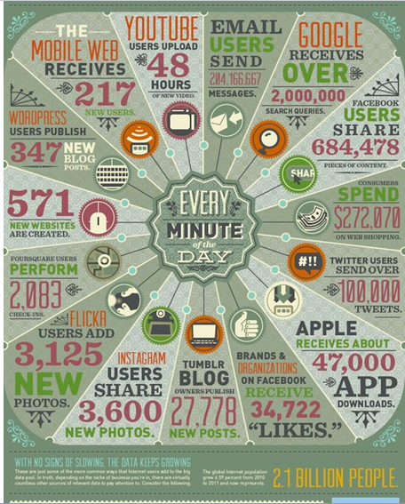
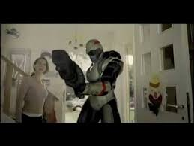
Where’s Klaus?
(AND WHO IS HE SPEAKING TO AND MEETING?)
WherE’S Klaus?
Notes:
To finish off, we are going to watch a short video, again produced by CEOP, which will hopefully leave you with some thoughts about how well protected your own children are in the ‘offline’ world compared to the lengths that you no doubt go to, to keep them safe in the ‘real’ world….
[Click on the red text, “Where’s Klaus?” to link to video]

Slide 21









Any questions?
Notes:
Good luck to you, as you venture into the online world! Just remember that although technology may appear to change the way your child thinks, talks and behaves, in reality, deep down, they are still just the same as children from 10, 20, 30 years ago. They simply have a new way to communicate and explore the REAL world. Don’t forget that they are still YOUR child and they still really (although not always easy to see!) crave your attention, your knowledge, your reassurance, your boundaries and your guidance....don’t let the online world make you lose sight of that!

Slide 22
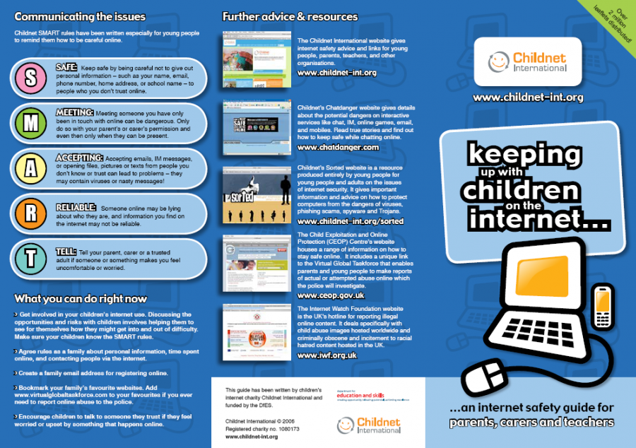
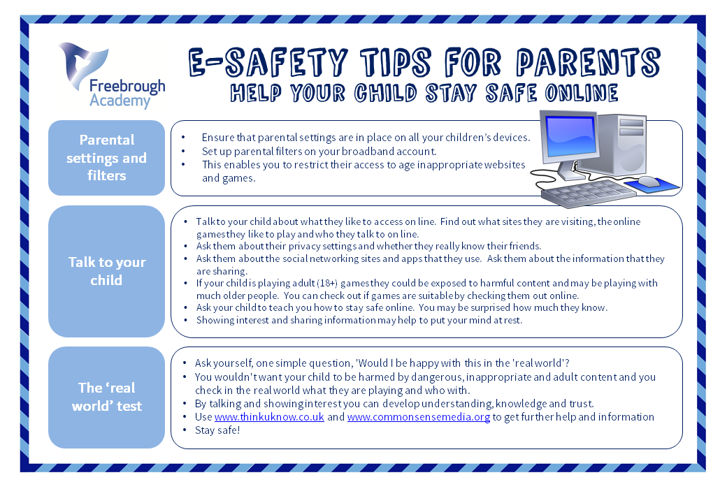
Useful sites for further information
net-aware.org.uk/
kidsmart.org.uk/
google.co.uk/intl/en/safetycenter/
childnet.com/resources/star-toolkit
nspcc.org.uk/
internetmatters.org/
thinkuknow.co.uk/
esafety-adviser.com/
vodafone.com/content/digital-parenting/learning-and-fun/digital-parenting-magazine.html
o2.co.uk/help/nspcc
Notes:
There are so many great sites out there. It is really just a case of trying each one and finding the one which works best for you and your family. Many of these sites regularly update the latest ‘threats’ or issues so it is worth checking back in with each one regularly. All of these links are available in a leaflet that you can pick up as you leave the presentation.

